Slide 1
Connect4Impact ce
Financing options for investments in Ukraine
AHK Ukraine Roundtable
November 2023

Slide 2
DEG - Deutsche Investitions- und Entwicklungsgesellschaft
We shape transformation

Slide 3
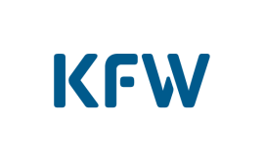
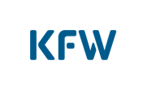
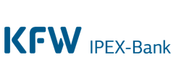
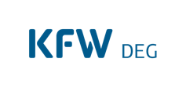
Part of a strong banking group
DEG, a subsidiary of KfW
Domestic promotion
International financing
We promote Germany
We ensure
internationalisation
We promote development
Mittelstandsbank & Private Clients
Digital
Retail business
Individual-
financing &
Public clients
Individual financing solutions
& Municipal
Financing
Participation
financing
Venture Capital
Investments
KfW IPEX Bank
International
Project &
Export financing
KfW Development Bank
Developing and
Emerging markets:
Financial cooperation
DEG
Developing and
Emerging markets:
Private sector
promotion

Slide 4

DEG in developing and emerging markets
Facts and figures (FY22)
1962
Founding date
638
Number of employees
Cologne
Europe: EUR 1.0bn
Asia: EUR 3.1bn
EUR 9.9bn
Global portfolio
Africa/MENA: EUR 2,7 billion
Abidjan
Lagos
Nairobi
EUR 1.6 bn
Annual commitments
Latin America: EUR 2.7bn
Johannesburg
EUR 2.5bn
Regional offices
Multi-country: EUR 0.4bn
€
Equity capital
Satellite
Portfolio
Headquarter
Currently EUR 55.6m DEG exposure in Ukraine + EUR 5m Connect4Impact and EUR 2.5m financial support via DEGImpulse

Slide 5
Connect4Impact
We finance progress

Slide 6
Connect4Impact
We finance progress
THE PROGRAMME
Promotional programme launched in 2019
Funded by the German Federal Ministry for Economic Cooperation and Development (BMZ) and implemented by DEG
Connect4Impact provides:
    attractive loans to subsidiaries of EU companies in developing and emerging countries
    access to the DEG network and wide-ranging expertise in developing and emerging-market countries based on 60 years of experience
Connect4Impact target countries
Focus: Ukraine
Non-target countries
CONDITIONS
Loans in EUR, USD and many local currencies
Terms of 3 to 7 years
Loan amounts from EUR 750,000 to EUR 5 million
Usually unsecured
Attractive conditions, with interest rate reductions for projects that have a particularly strong impact
Support for implementing international environmental and social standards
Lean financing for European companies in Africa and BMZ Partner countries (e.g. Ukraine) at attractive terms
Notes:
after 53 successfully provided financings, the programme will be expanded globally

Slide 7
Connect4Impact target country: Ukraine
Investments in Ukraine are particularly worthy of support
Global FDI into Ukraine | EUR 8bn (2021) EUR 0.2bn (2022) EUR 1.1bn (1Q2023)
GDP development | Decline in 2022 lower than expected and a moderate increase projected for 2023 (2%)
Economic recovery / Outlook | International donors secure continuous financial aid Growing demand of business loans Investment guarantees granted for long-term loans, full coverage Available workforce as unemployment rate doubled
German business | More than 200 German investors are active in Ukraine maintaining roughly 35k jobs (2023) EUR 4.1bn German FDI portfolio in Ukraine (stock in 2021)
Our Pipeline | 5-10 German companies
Notes:
Hoher Bestand Deutscher FDI in Ukraine: Höchster Bestand in einem BMZ Partnerland im Europäischen Raum (Quelle: Deutsche Bundesbank)
Global FDI zeigt den rapiden Rückgang durch den Krieg. In vielen Schwellen- und Entwicklungsländern kann nach Krisen (z.B. Covid-19) ein deutlicher Wiederanstieg beobachtet werden. (Quelle: GIZ Studie)
E.g. Bayer is investing EUR 60m in its seed plant near Kiev (1.5k jobs)
Insb. Kriegsrisiken und Konvertierungs- und Transferrisiken

Slide 8
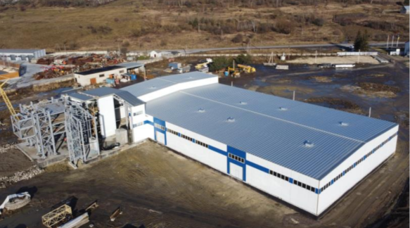
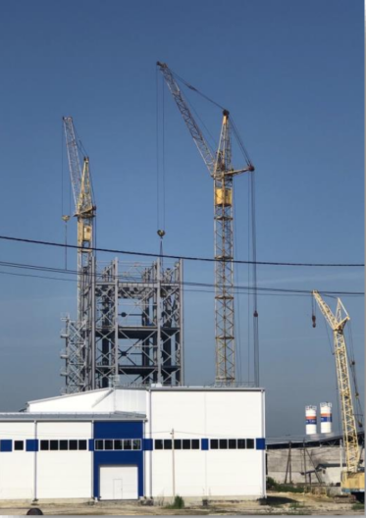
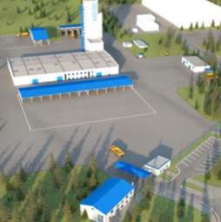
First success story in Ukraine
Construction of a production facility for building materials in Ukraine
The Client
  The German group is a manufacturer of high-quality building materials, incl. Mortar, plaster and thermal insulation systems.
  The group has been active in Ukraine through its subsidiary since 2007.
  The Investment
  Construction of a new, additional production facility for building materials in Lviv to expand local production capacities.
  Linking various BMZ and BMWK instruments: in addition to financing from Connect4Impact, the company receives an investment guarantee from the German government to cover war risks as well as conversion and transfer risks.
  Developmental Impact
  The production of building materials is of significant importance for reconstruction in Ukraine.
  60 new, permanent jobs will be created.
  Offer of application-related training for end customers in Ukraine.

Slide 9
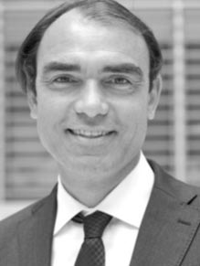
Thank you for your attention
Any questions?
Klaus Helsper
Head of Department
Connect4Impact
+49 221 4986 1783
klaus.helsper@deginvest.de

Slide 10
DEG - Deutsche Investitions- und Entwicklungsgesellschaft
We shape transformation
Infos tbd.
DEG Classic
Financings up to EUR75m
Connect4Impact
Up to EUR 5m
Loan in EUR/USD/LCY
E&S support
Currently EUR 55.6m exposure in Ukraine with growing pipeline
As of now EUR 5m loan (Connect4Impact pilot) in Ukraine with ~ EUR 30m in pipeline
DeveloPPP, UpScaling, BSS (Business Support Services)
Up to EUR 2m
Grants possible
Co-financing of e.g. feasibility studies, etc.
Presently EUR 2.5m invested in Ukraine

Slide 11
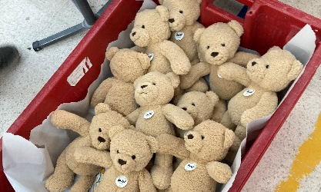


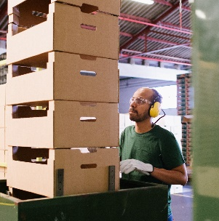
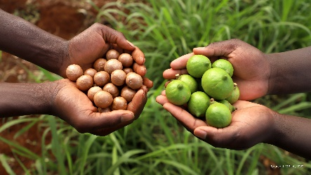


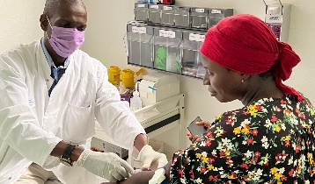
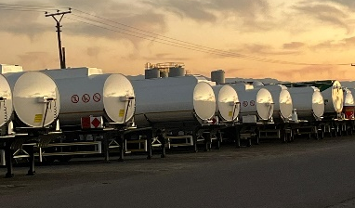

Committed projects
Many countries. Many sectors. One success story.
Klingele, Senegal
Sustainable packaging for African agriculture & fishing industry
35 new jobs
Innovative processing technology transfer
Steiff, Tunisia
Soft toy production
Securing more than 800 jobs
Technological development and knowledge transfer
161.1
> 7,600
Mio. EUR loan volume granted
Jobs created
Oran
Algiers
Tunis
Mediterranean
Sea
54
> 9,100
Casablanca
Rabat
Constantine
TUNISIA
MOROCCO
Tripoli
financing committed in 15 African countries
Jobs secured during COVID-19 pandemic
Marrakech
Bechar
ALGERIA
Banghazi
Alexandria
Cairo
Laâyoune
LIBYA
EGYPT
WESTERN SAHARA
Tamanrasset
Al Jawf
Aswan
Red
Sea
MAURITANIA
MALI
Faya-Largeau
Port Sudan
Limbua, Kenya
Sustainable, organic fruit and nut production
170 new jobs
Certified employer
Training for local smallholders
Nouakchott
Tombouctou
NIGER
Nema
Agadez
CHAD
Khartoum
ERITREA
Dakar
SENEGAL
Zinder
Asmara
Banjul
Bamako
Niamey
Al Fashir
THE GAMBIA
Ouagadougou
N' Djamena
DJIBOUTI
Bissau
BURKINA FASO
Kano
Maiduguri
Djibouti
GUINEA BISSAU
GUINEA
BENIN
SUDAN
Berbera
Conakry
Abuja
Addis
Ababa
Freetown
CÔTE
D’IVOIRE
TOGO
NIGERIA
Waw
SIERRA LEONE
GHANA
CENTRAL
AFRICAN
REPUBLIC
ETHIOPIA
SOMALIA
Monrovia
Accra
Juba
LIBERIA
Abidjan
Loma
Lagos
CAMEROON
Bangui
Porto-Novo
Malabo
Yaounde
UGANDA
KENYA
Mogadishu
EQUATORIAL GUINEA
REPUBLIC
OF THE
CONGO
Kisangani
Kampala
Libreville
GABON
DEMOCRATIC
REPUBLIC
OF THE CONGO
(ZAIRE)
RWANDA
Nairobi
Indian
Ocean
Kigali
Lake
Victoria
Brazzaville
BURUNDI
Mombasa
Pointe-Noire
Kinshasa
Kananga
Bujumbura
Lake Tanganyika
Atlantic
Ocean
ANGOLA
Kalemie
Zanzibar
Luanda
TANZANIA
Dar es Salaam
Malanje
Mbeya
Lobito
ANGOLA
MALAWI
Lake
Nyasa
Menongue
Ndola
Lilongwe
Nacala
Namibe
ZAMBIA
Lusaka
Harare
MOZAMBIQUE
MADAGASCAR
NAMIBIA
ZIMBABWE
Antananarivo
Das Labor., Togo & Benin
Medical diagnostics services
60 new jobs
Know-how Transfer
Windhoek
BOTSWANA
Bulawayo
Beira
Toliara
GRW /
Schmitz Cargobull, South Africa
Trailer production (trucks)
60 new jobs
${CO}_{2}$-Footprint reduction due to installation of solar power system
Walvis Bay
Gaborone
Pretoria
Luderitz
Johannesburg
Mbabane
Maputo
Maseru
SWAZILAND
LESOTHO
Durban
Indian
Ocean
Cape Town
SOUTH
AFRICA
Port Elizabeth
Countries with committed AC financings
Countries without committed AC financings
Notes:
Erfolgsprogramm AfricaConnect als Basis.
UKR Deal ist hier schon mit drin, da Pilotvorhaben

Slide 12


Connect4Impact
What information is needed?
1
2
3
A description of your company
The last two audited annual financial statements of the European group and the local subsidiary
A qualitative and quantitative business plan that shows sustainable development over the coming years
4
5
6
An organisational chart showing the corporate structures of the company and of the group
Evidence of a strong economic link to the EU, e.g. registered office of the group of companies
A description of the developmental impact of the investment, in particular the planned jobs

